Slide 1

12v Battery EV Battery Charging Circuit Using LM317

Slide 2

PRESENTED BY,
Mamun Ahmed
ID: 222901019
Moyan Uddin
ID: 222901001
Shariar Masud Sarker
ID: 222901008
Naimur Ratul
ID: 221901041
Tahmina Akter
ID: 222901002
PRESENTED TO,
Sourav Chandra Das
Lecturer
Department of EEE
Green University of Bangladesh

Slide 3
01.
INTRODUCTION
02.
PROJECT DESCRIPTION
TABLE OF CONTENTS
03.
COMPONENTS REQUIREMENT
04.
CIRCUIT DIAGRAM
05.
06.
PROJECT PHOTOGRAP
07.
APPLICATIONS
08.​
ADVANTAGES
09.​
BLOCK DIAGRAM
LIMITATIONS
10.
WORKING PRINCIPLE
CONCLUSION

Slide 4

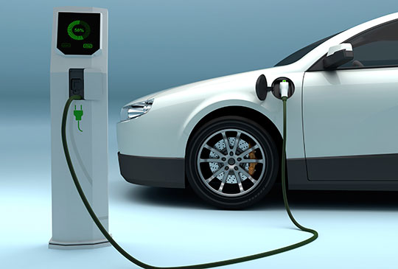
INTRODUCTION
EV Battery Charger
Lead Acid Battery
Battery Charging Circuit
Educational and practical

Slide 5
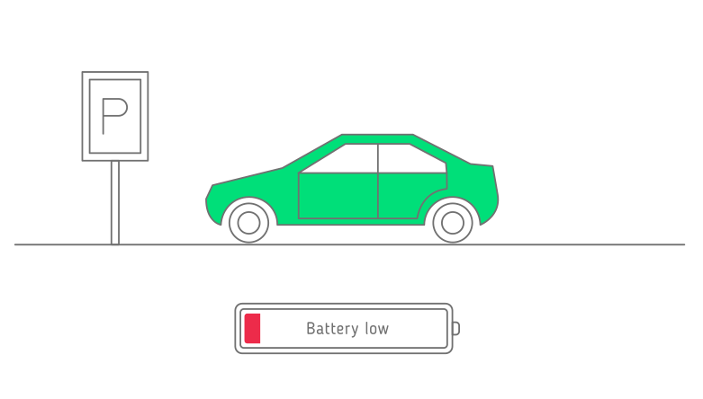
Project Description
This project builds a 12V battery charger using an LM317 regulator. It converts 220V AC to DC via a transformer and rectifier, stabilizes it with capacitors, and charges a lead-acid battery. An Arduino Nano monitors voltage, displaying data on an OLED, making it ideal for learning electronics and battery charging.

Slide 6
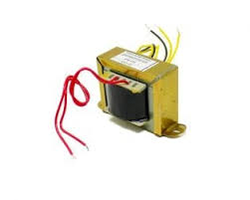
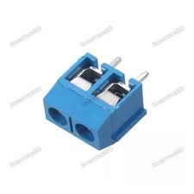
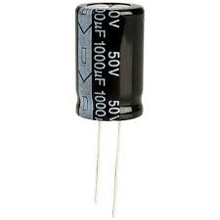
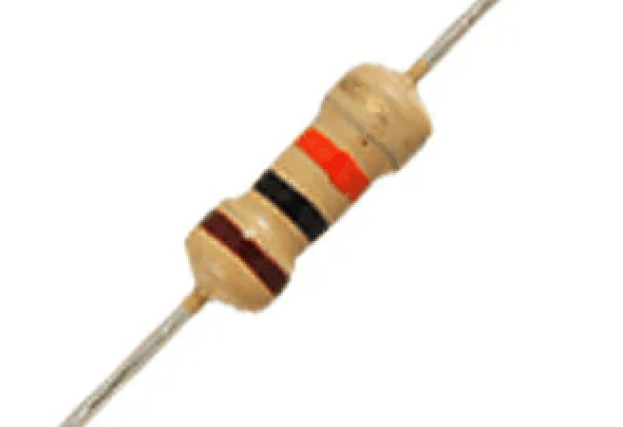
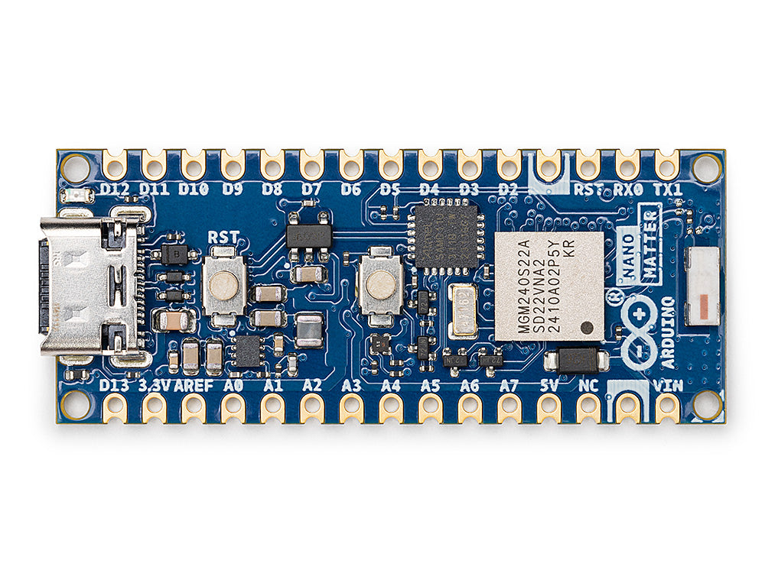
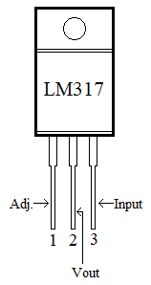
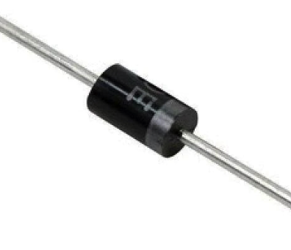
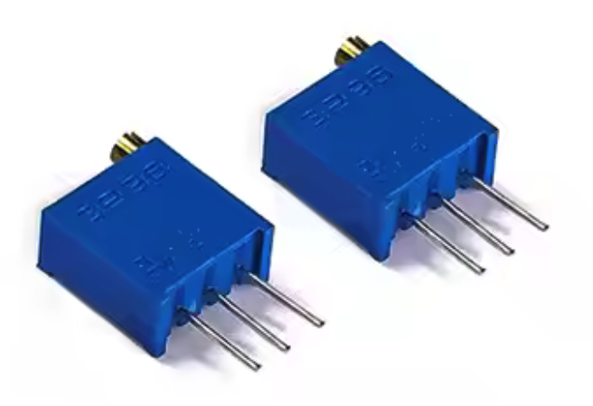
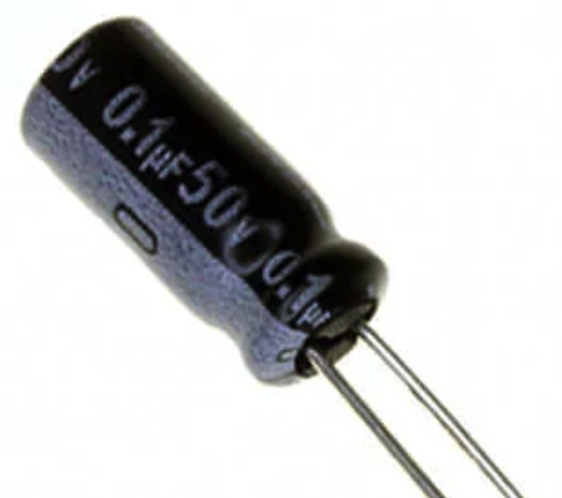

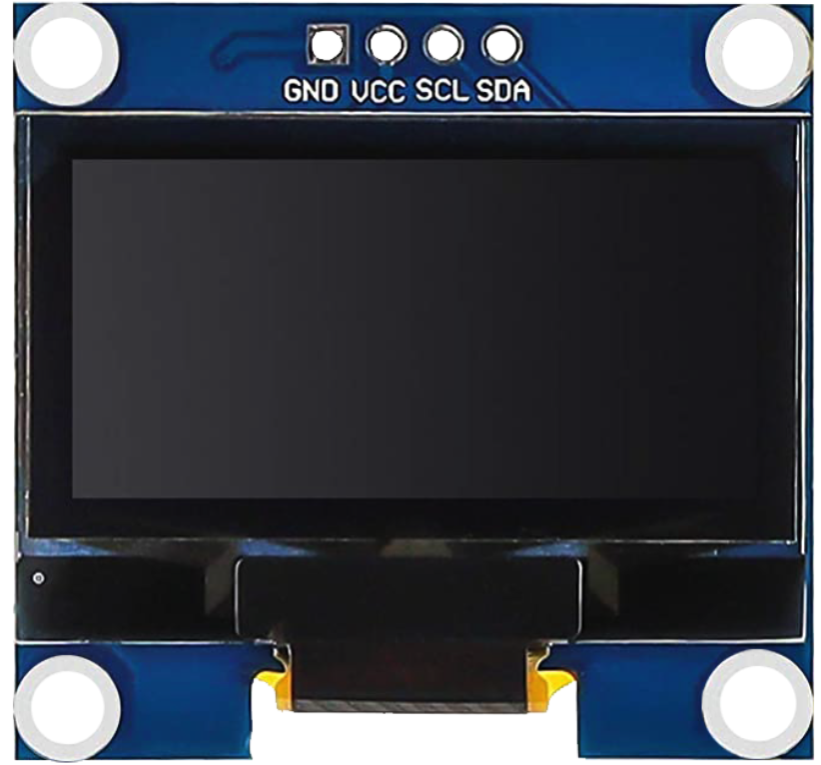
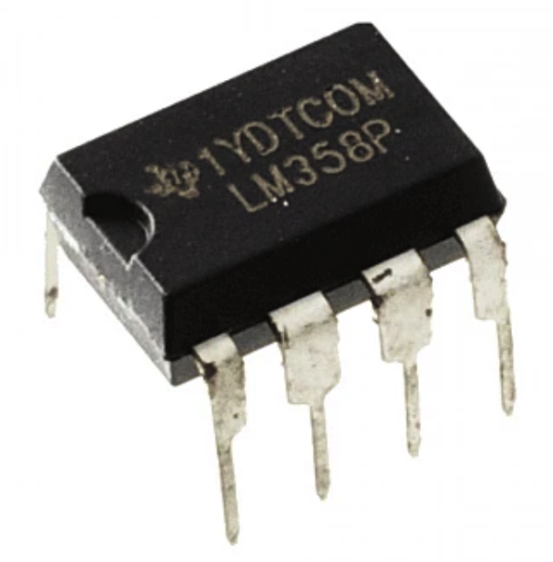
COMPONENTS REQUIREMENT
Copper Clad Board
Transformer 12V 3Amp
IC LM317 (2)
Connector Terminal Block (2)
Capacitor 1000uF, 1uF, 0.1uF (5)
Variable resistor (2)-10k, 1k
Resistor 1k (5), 10k
Diode- 1N4007 (7)
LM358 – Op-amp
0.04R - wire
OLED Display
Arduino Nano

Slide 7
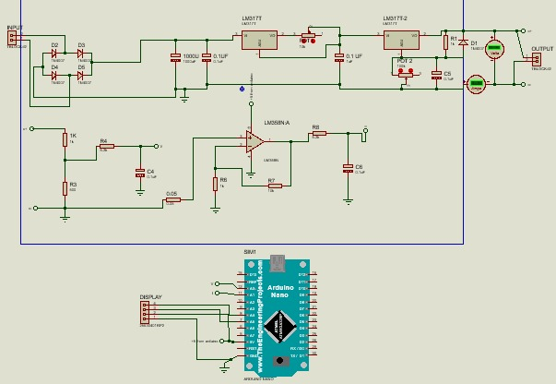
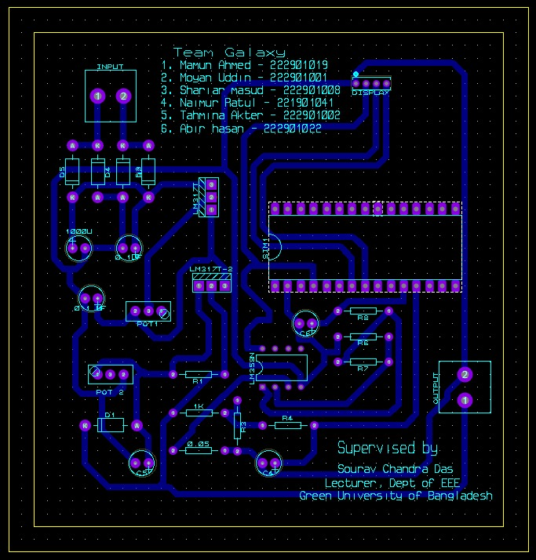
Circuit Diagram and PCB Design
PCB Design of 12 v Charging Circuit
Circuit diagram 12 v charging circuit

Slide 8

Working Principle
The circuit converts 12V AC to DC using a bridge rectifier and smooths it with a 1000µF capacitor.
The LM317 regulator maintains a stable 13.8V output for safe battery charging.
A shunt resistor and LM358 op-amp measure charging current, which the Arduino Nano monitors in real time.
Battery voltage and current are displayed on an OLED display.
Additional capacitors filter noise, and a 1N4007 diode prevents reverse current flow.

Slide 9
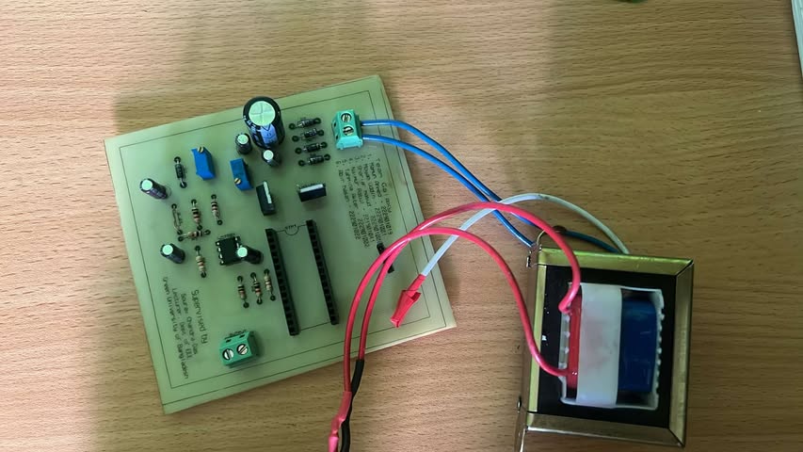
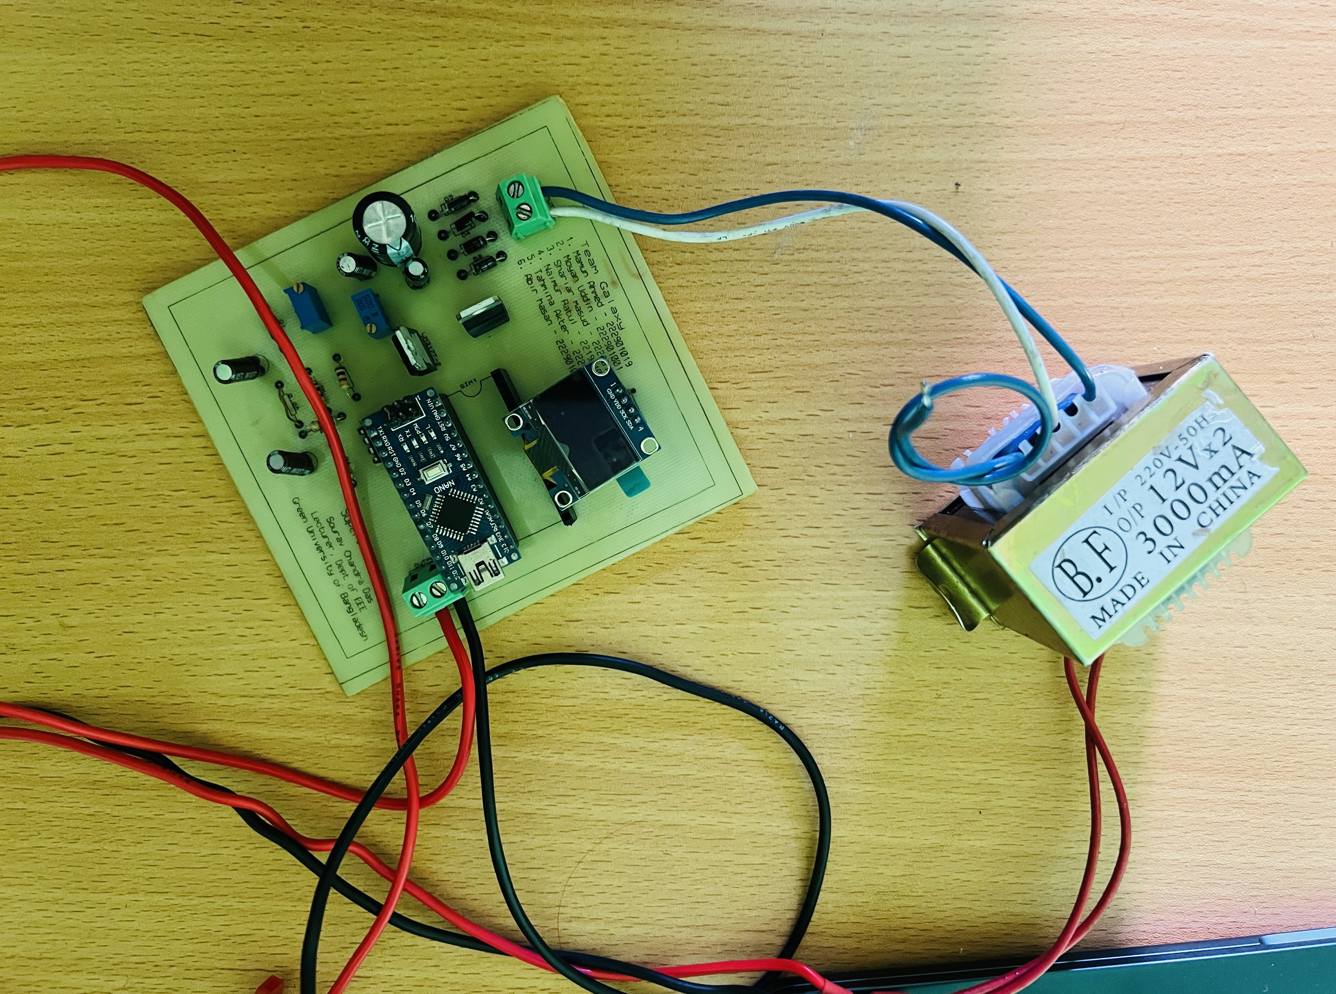
PROJECT PHOTOGRAPH

Slide 10


APPLICATIONS
Charging 12V Lead-Acid Batteries
Power backup systems
Solar battery chargers
DIY electronics and hobby projects
Small DC power supply systems

Slide 11


ADVANTAGES
Simple and low-cost design
Adjustable output voltage
Easily available components
Visual voltage monitoring via OLED
Safe battery charging with controlled current

Slide 12



LIMITATIONS
Not suitable for large capacity batteries (>7Ah)
LM317 generates heat; requires proper heat sinking
No overcharge protection (can be added)
Efficiency is lower compared to switching regulators
Limited current output (1.5A max typically)

Slide 13

CONCLUSION
This project showcases a safe and efficient 12V battery charger using an LM317 regulator with Arduino-based real-time monitoring on an LCD. It offers hands-on learning in voltage regulation and microcontroller interfacing. Future upgrades could include auto cut-off, cooling fan, digital voltmeter, and solar power support.

Slide 14


